Slide 1
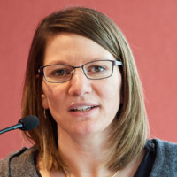
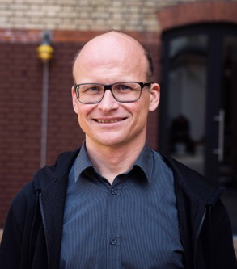

2025 IHE-Europe Connectathon ~ What’s new in IHE IT-Infrastructure ~
Anne-Gaëlle Bergé
IHE Connectathon Technical Manager
Oliver Egger
eHealth Architect Founder of ahdis.ag IHE International ITI Technical Commitee Co-Chair IHE Suisse member, HL7.ch member
John Moehrke
Architect: Healthcare Informatics Standards - Interoperability, Privacy, and Security IHE Co-Chair IT Infrastructure Planning and Technical HL7 Co-Chair Security WG, FHIR FMG, FHIR facilitator, and FHIR Foundation founding member

Slide 2
Agenda
Vienna Connectathon - What’s happening? How can I join?
Introduction of the IT-Infrastructure domain: what does it cover in terms of business cases
What is new since the last Connectathon?
Focus on hot profiles
Resources
Contact us
Q&A session

Slide 3

IHE-Europe Connectathon in Vienna
IHE Connectathon is a formal interoperability testing event.
It is the best place to
Test the IHE implementation of your product
Find and fix bugs in your product
Complete the last mile of your software development
Share with experts, including the authors of the IHE Profiles
Meet other professionals who face the same challenges as you do
Learn from the community
Join us at Vienna Allianz Stadion, June 23-27, to test your product nearly on the field

Slide 4
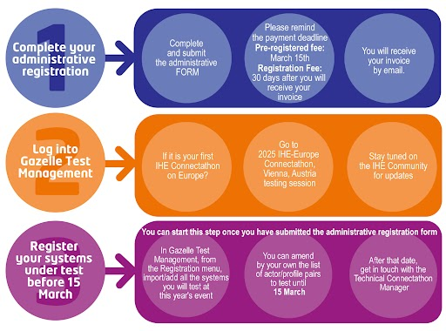
How to register for the event?
https://connectathon.ihe-europe.net/connectathon-week-2025

Slide 5
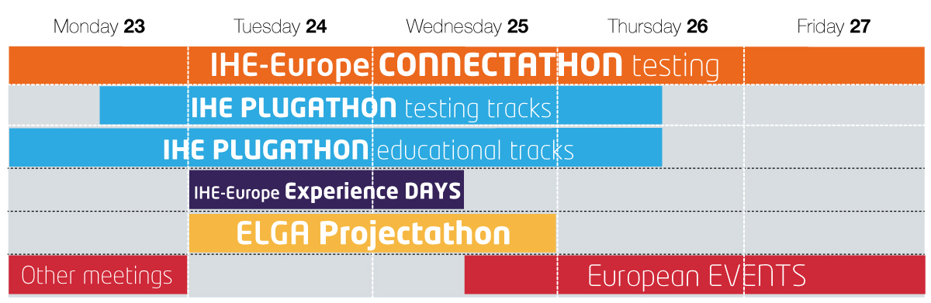
Other interoperability events happening in Vienna
Link to IHE-Europe Experience days webpage

Slide 6
IT-Infrastructure
The IT Infrastructure Domain defines interoperable infrastructure for the secure sharing of healthcare information independent of clinical domain. Interoperable infrastructure is necessary to support common IT functions for a variety of use cases but is rarely visible to the end user.
Components supporting interoperable infrastructure may be embedded in applications but are often deployed as a shared resource within an organization or a regional or national health information exchange.
IHE ITI was established by HIMSS & RSNA in 2002 in order to address use cases that cross multiple clinical domains and rely on a common IT Infrastructure.

Slide 7
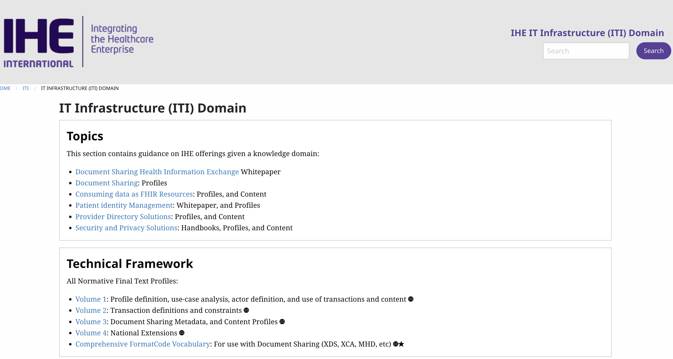
IT-Infrastructure
https://profiles.ihe.net/ITI/

Slide 8
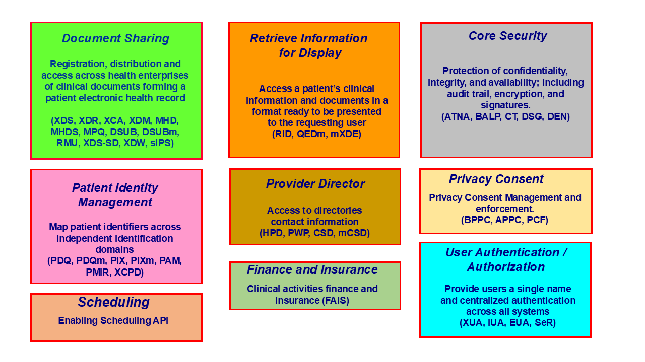
IT-Infrastructure
https://profiles.ihe.net/ITI/TF/Volume1/ch-2.html

Slide 9
ITI – Profiles most tested at CAT
Consistent Time (CT)
Audit Trail and Node Authentication (ATNA)
Cross-Enterprise Clinical Documents Share (XDS.b)
Mobile access to Health Documents (MHD)

Slide 10
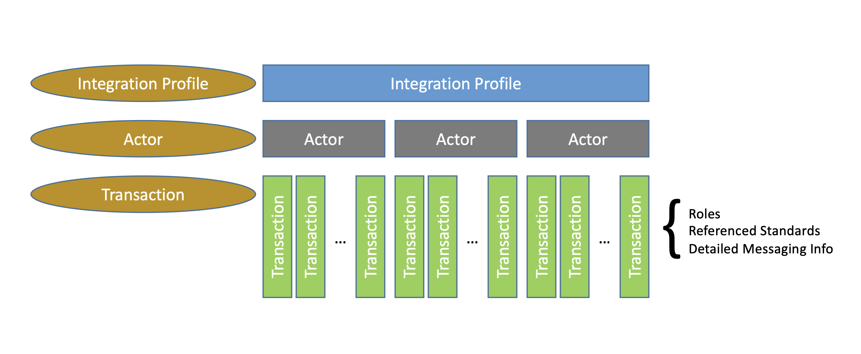
IT-Infrastructure
https://www.ihe.net/about_ihe/faq/ - What_is_the_IHE_Technical_Framework?

Slide 11
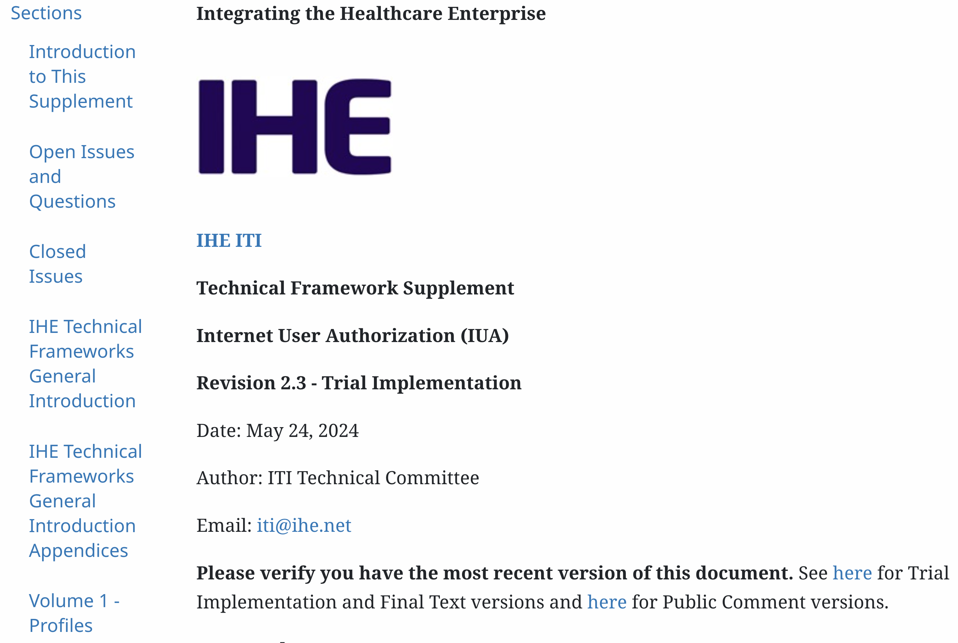
Internet User Authorization (IUA)
https://profiles.ihe.net/ITI/IUA/index.html

Slide 12
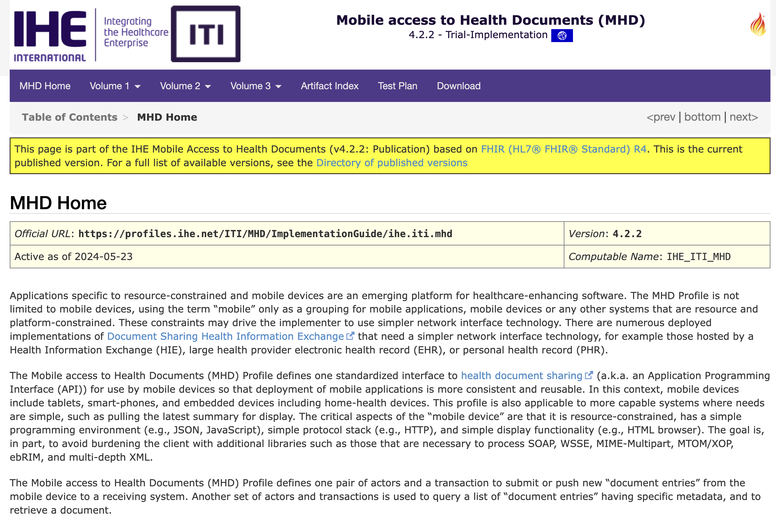
Mobile access to Health Documents (MHD)
https://profiles.ihe.net/ITI/MHD/index.html

Slide 13
IHE Profile Development Process
Allmost all IHE «mobile» Profiles are now published as FHIR Implementation Guides with
Actors, Transactions defined
Conformance Resources (StructureDefinitions, ValueSets, CodeSytems, ConceptMaps, Extensions etc)
and with examples!
Facilitates also testing because Implementation Guides can be used for validation during development.

Slide 14
IHE Profile Development Process
IHE ITI Planning Committee and Technical Committee
Work Item Proposal
Monthly Planning Meeting
Bi-weekly Telcos for Work Items
4 yearly F2F or virtual weekly meeting for work item development
Public Comment Phase
Trial Implementation
https://github.com/orgs/IHE/projects/8

Slide 15
Major Profile Updates since June 2024
New Profiles:
Finance and Insurance Service (FAIS) Release 1.0.0
Scheduling Release 1.0.0
Public Comment (to be announced)
ITI sex and gender profiling
mCSD additional transaction for Feed
https://profiles.ihe.net/ITI/

Slide 16
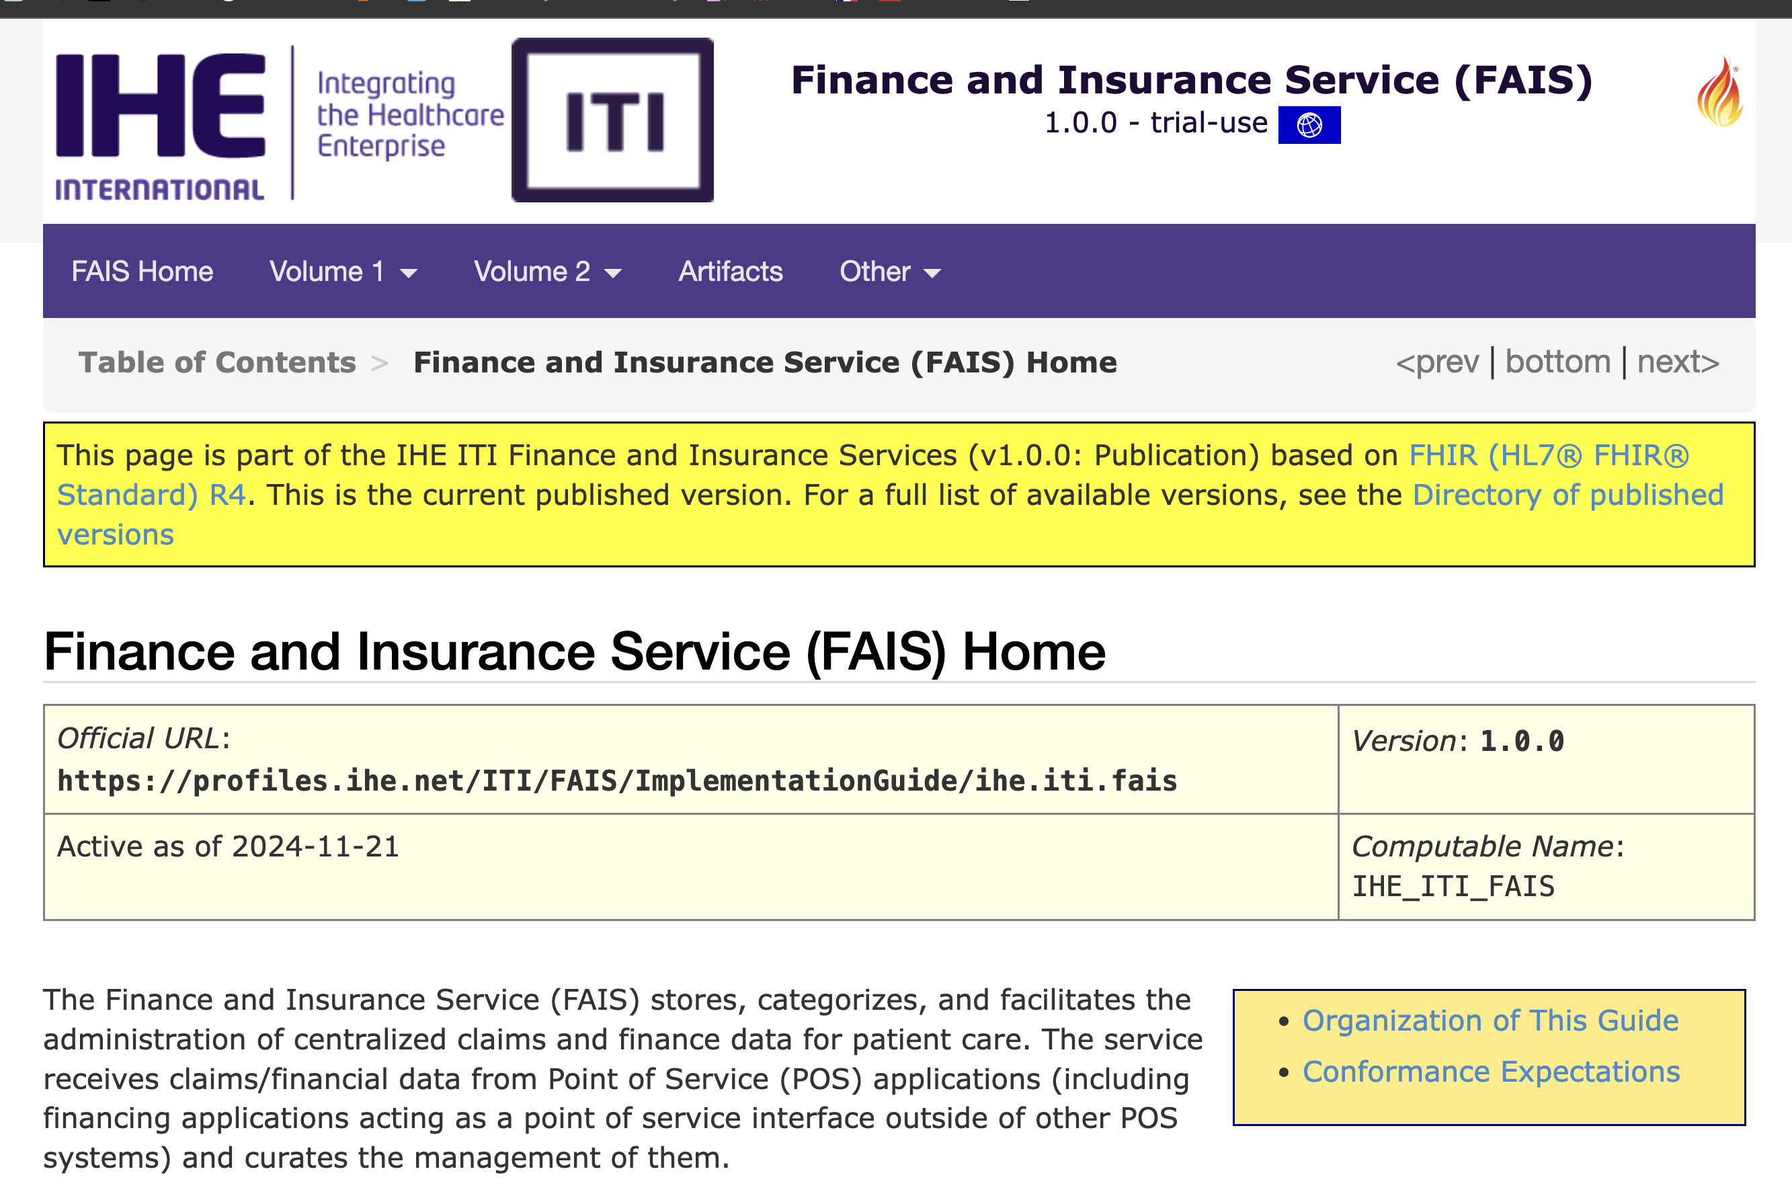
Hot profiles for CAT – FAIS
Finance and Insurance Service (FAIS) Release 1.0.0
https://profiles.ihe.net/ITI/FAIS/index.html

Slide 17
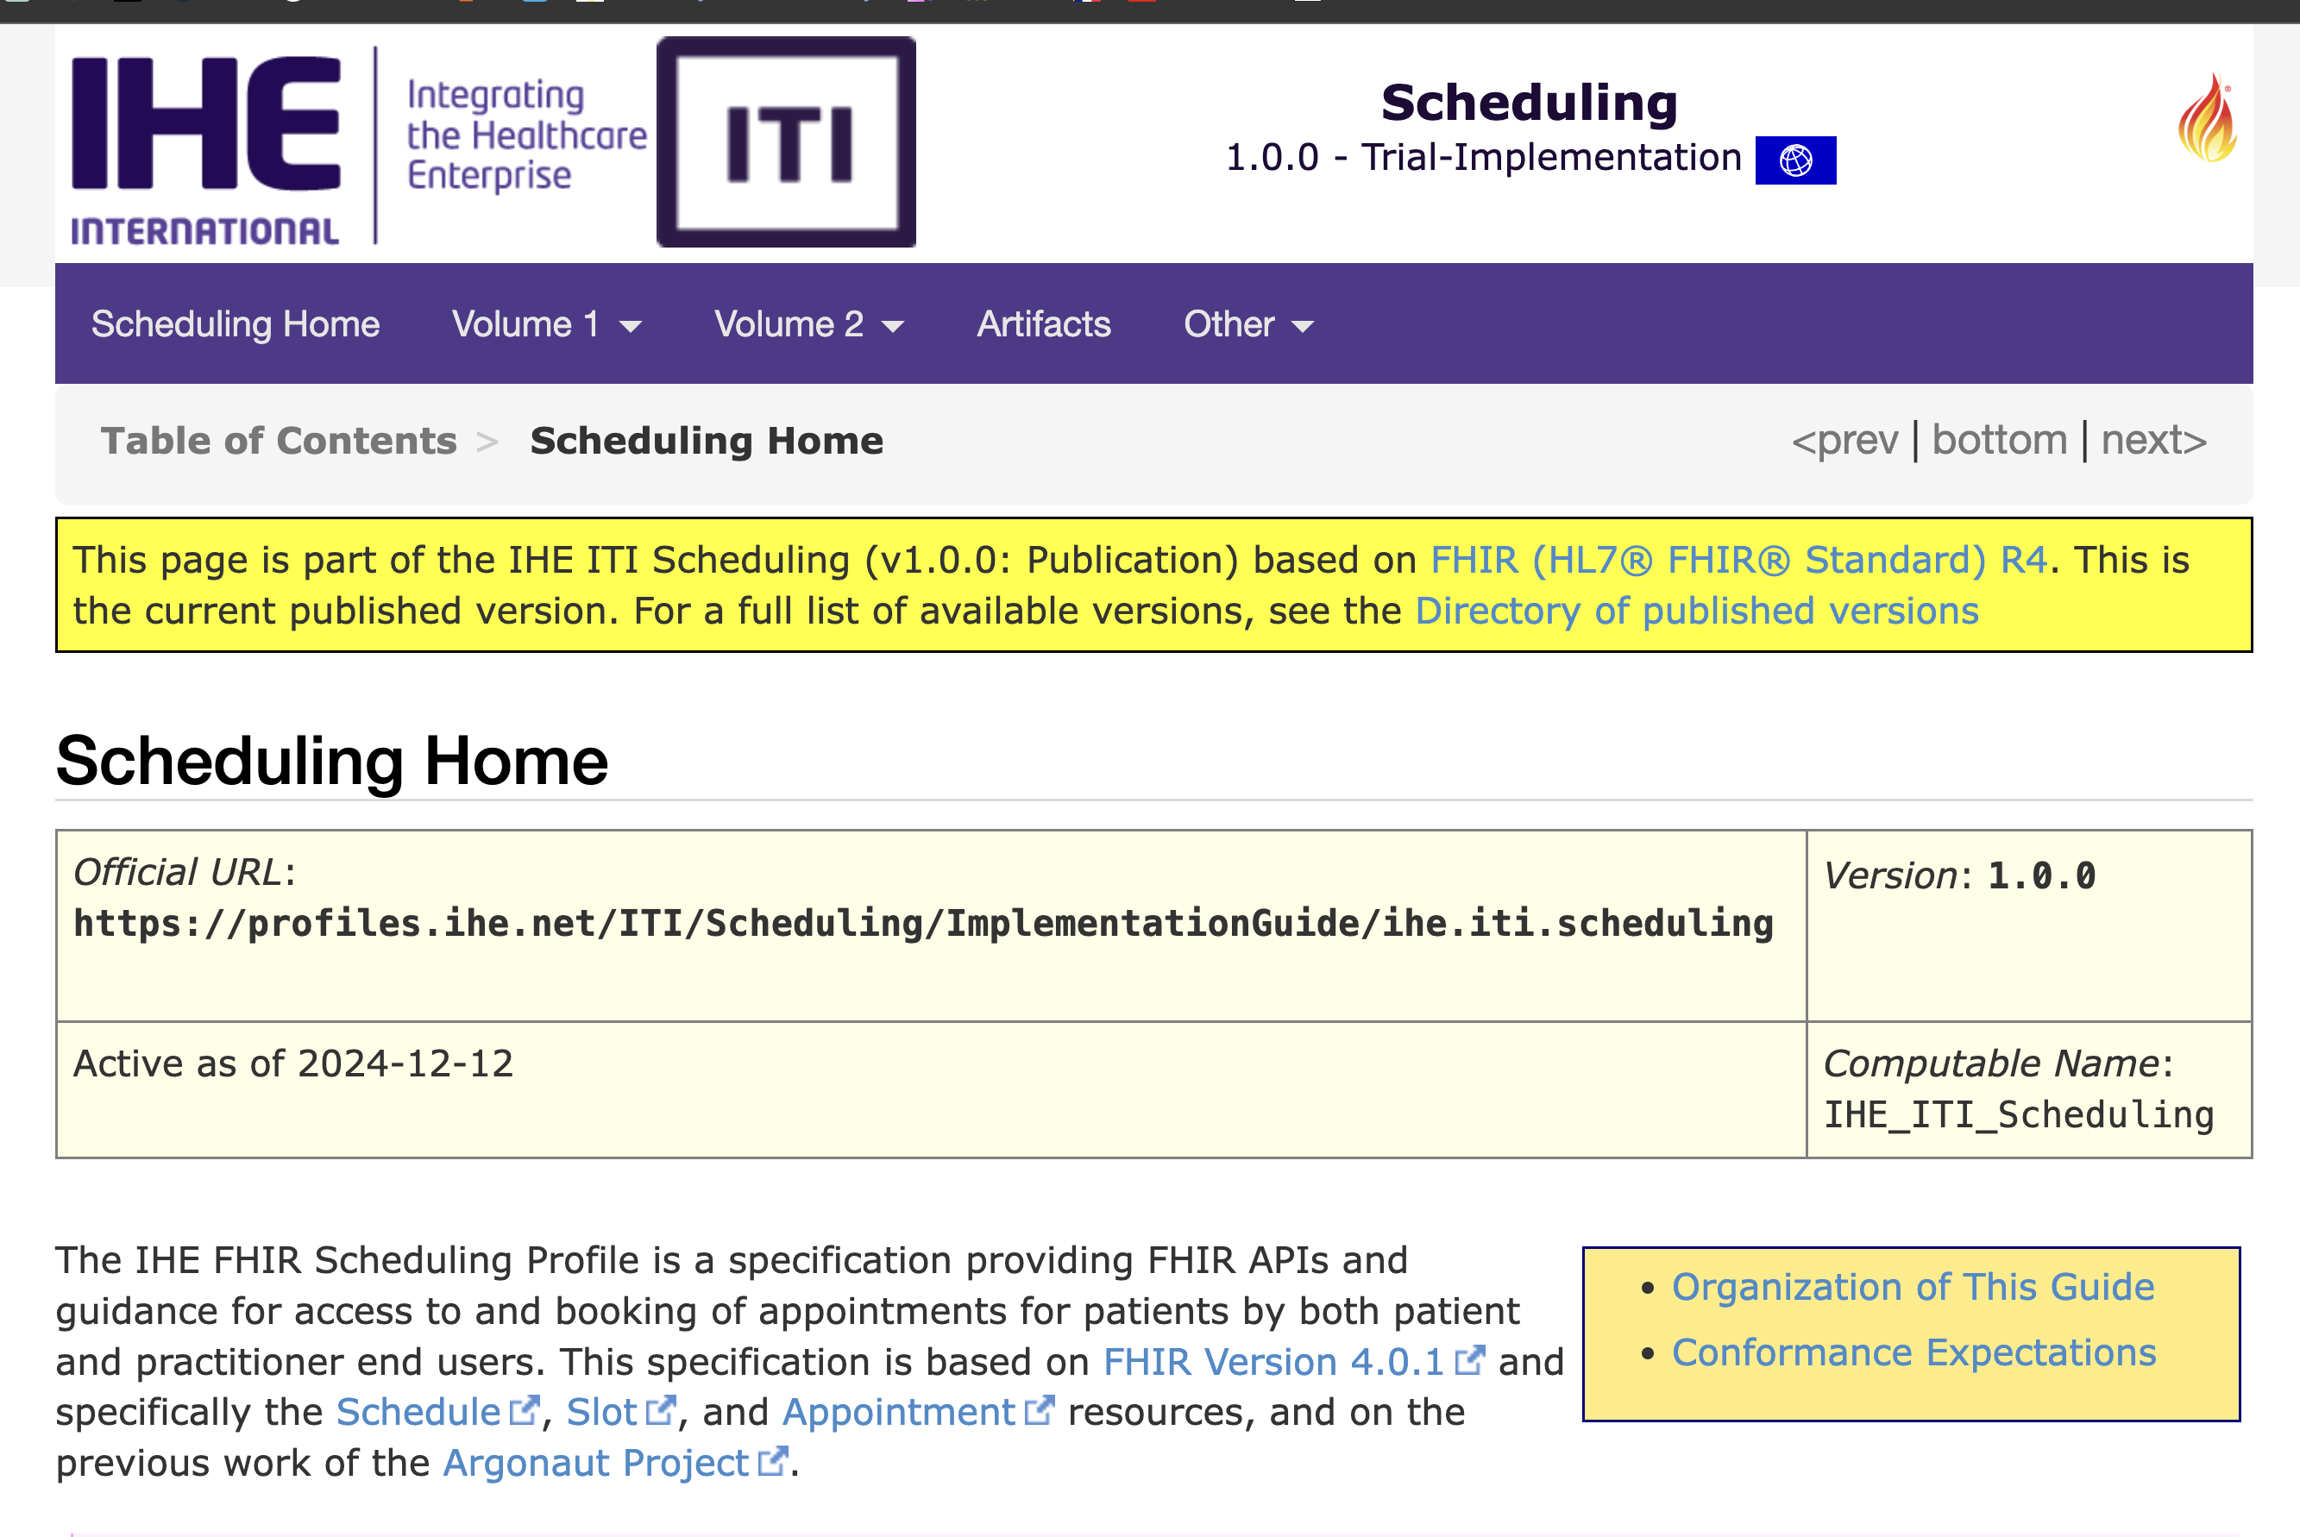
Hot profiles for CAT – Scheduling
https://profiles.ihe.net/ITI/Scheduling/index.html

Slide 18
Change Proposal (CP) Integration
Technical Framework Revision 20.1
Document Digital Signature (DSG) addition of JSON Signature
DSUB extensions was updated to add more subscription capability, similar to DSUBm.
XDS/XCA / XCPD / XUA / Volume 3
Supplement
Add RESTful ATNA (Query and Feed)
Internet User Authorization (IUA) Revision 2.3 - Trial Implementation
Profiles in Implementation Guides
Mobile Care Services Discovery (mCSD) Release 3.9.0 (history)
Patient Demographics Query for Mobile (PDQm) Release 3.1.0 (history)
Mobile access to Health Documents (MHD) Release 4.2.2 (history)
ITI TF volume integration: https://github.com/IHE/publications/releases
Change Proposals overview

Slide 19
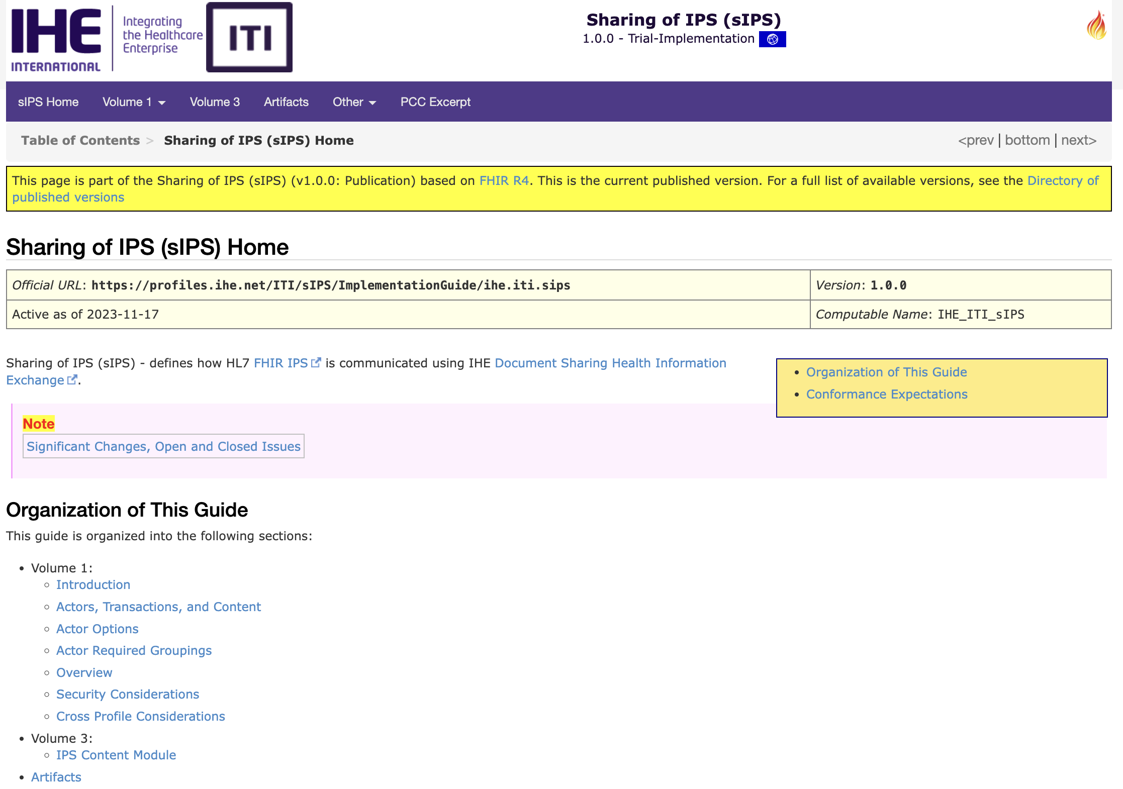
Hot profiles for CAT – sIPS
Publishing an IPS
On Demand Access to an IPS
Retrieving an IPS
Pushing an IPS to a Recipient
Will add support for CDA IPS
https://profiles.ihe.net/ITI/sIPS/

Slide 20
In development in ITI
Sharing Verifiable Health Links (VHL)
ITI XCDR Endpoint Addressing
De-identification handbook update (DeId)
XCA federation of MHDS community
https://github.com/IHE/IT-Infrastructure/projects/2

Slide 21
Resources
Summary of all the IHE ITI profiles:
https://profiles.ihe.net/ITI/index.html

Slide 22
To Contact Us…
Anne-Gaëlle Bergé - IHE EU Connectathon Technical Manager
technical.manager@ihe-europe.net
Oliver Egger - IHE ITI Technical Committee Co-Chair
oliver.egger@ahdis.ch
John Moehrke - IHE ITI Planning Committee Co-Chair
johnmoehrke@gmail.com

Slide 23

Questions??

